Slide 1
Unit-2

Slide 2
Problem Reduction
When we divide complex problems into sub-problems, all these sub-problems will have some relationships:
i. AND (Example: writing in notebook)
ii. OR (Example: Unlock phone)
The structure called AND-OR graph (or tree) is useful for representing the solution of complicated problems.

Slide 3
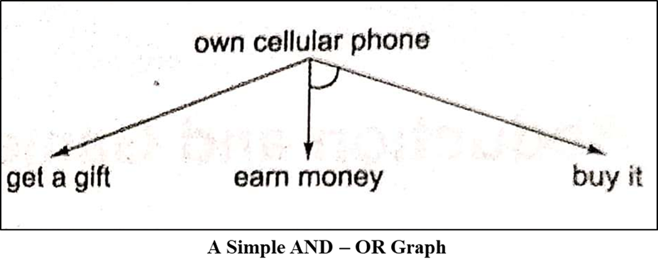
Problem Reduction

Slide 4
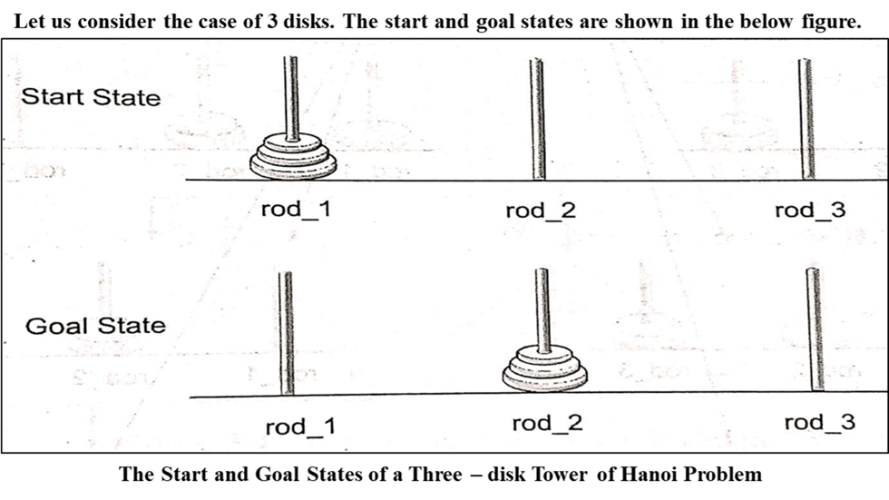
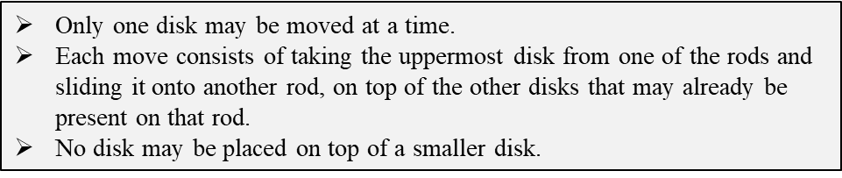
Example:

Slide 5
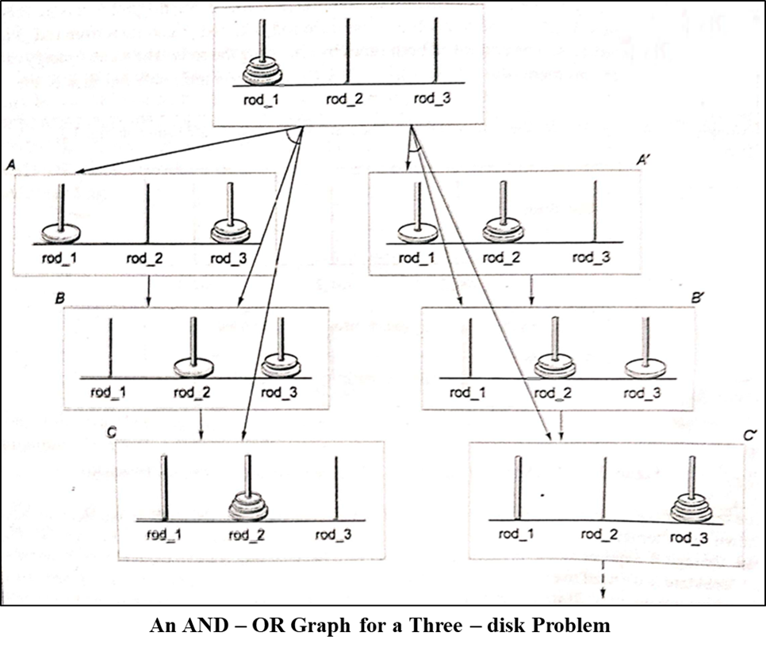

Slide 6
Difference between A* and AO* algorithms

Slide 7
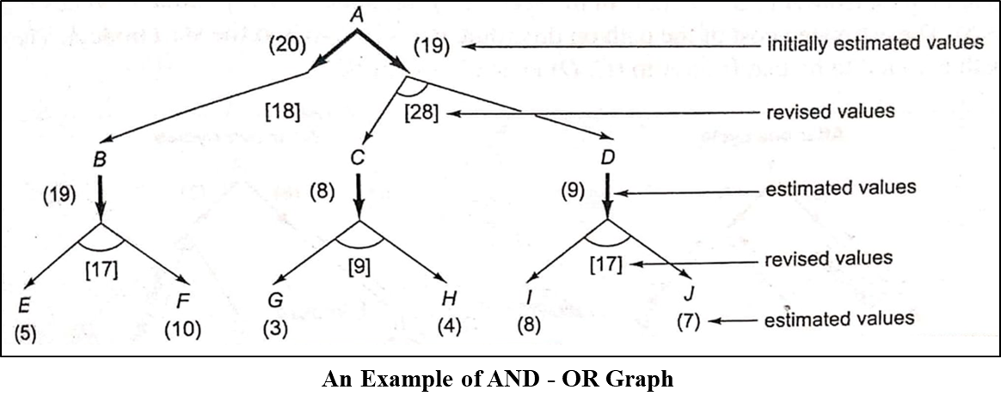
Example for AO*

Slide 8
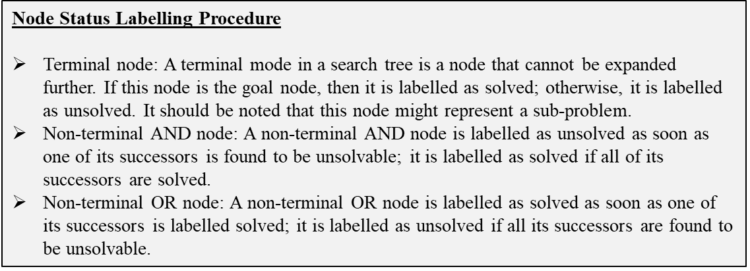

Slide 9
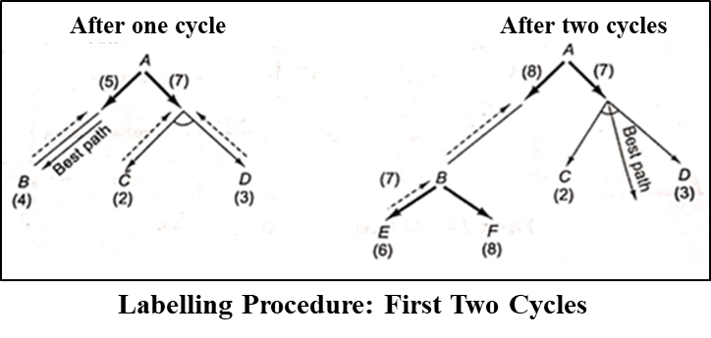
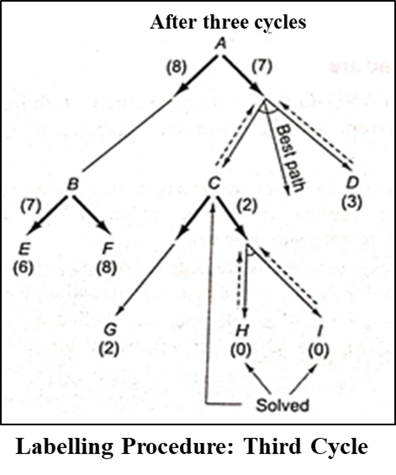
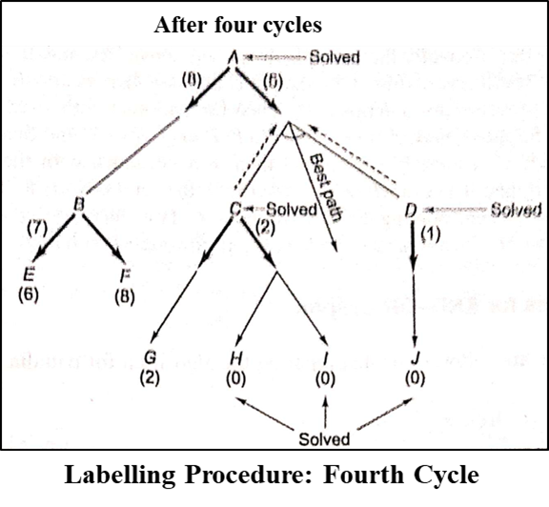
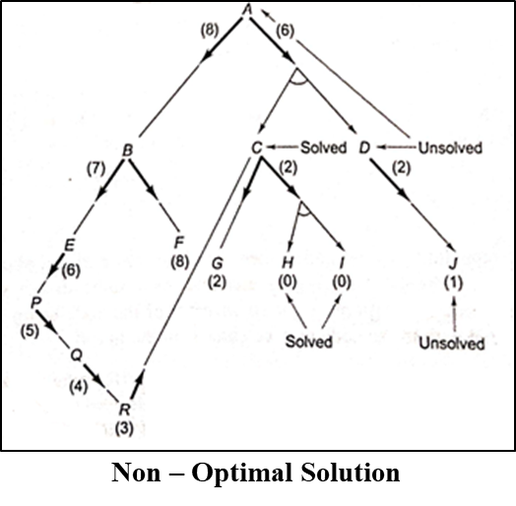

Slide 10
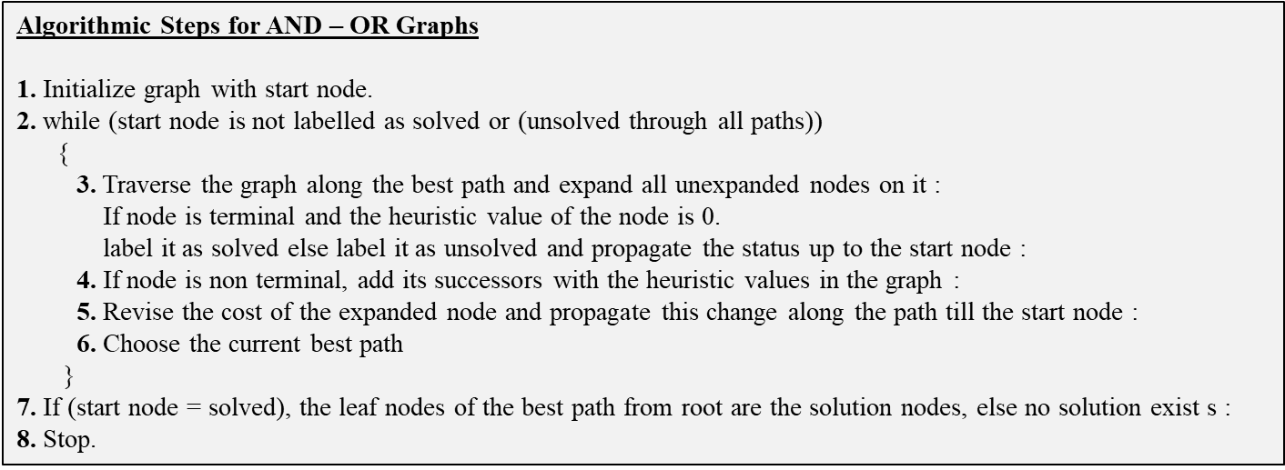

Slide 11
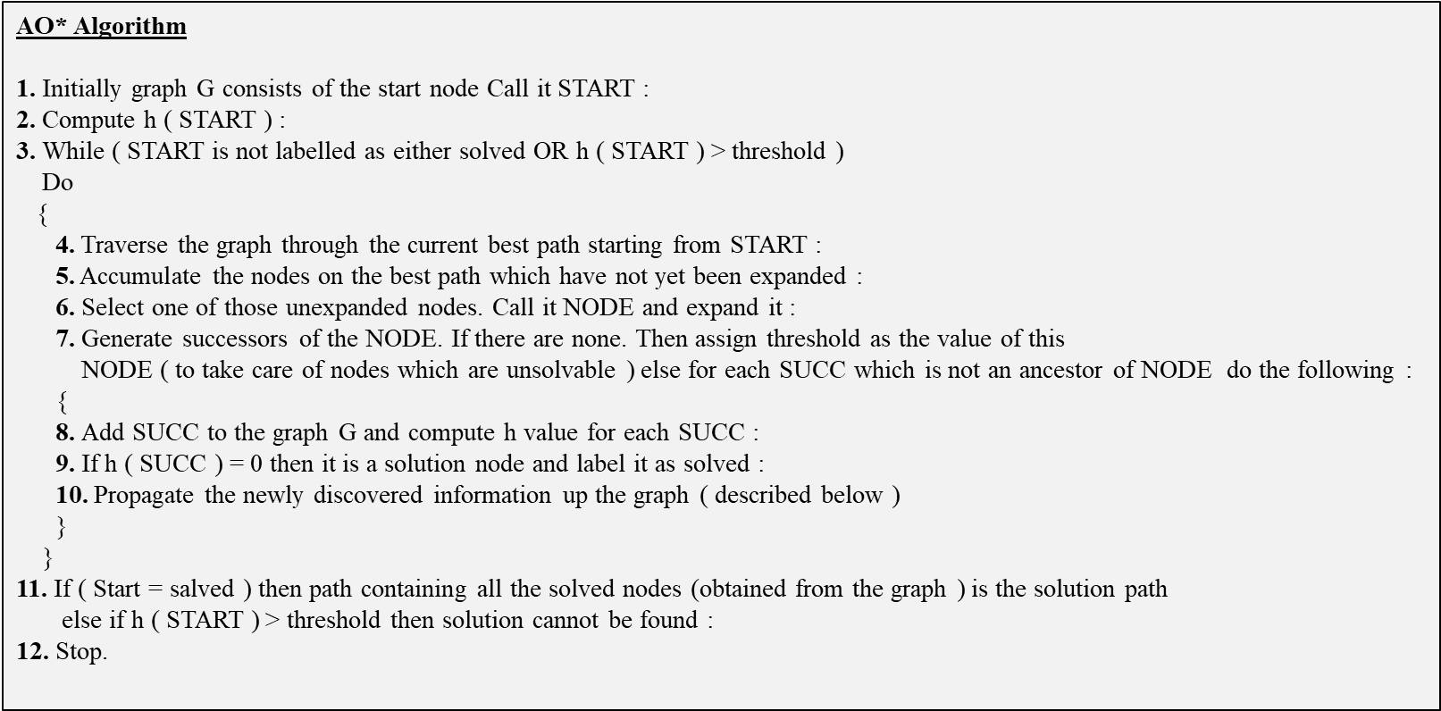

Slide 12
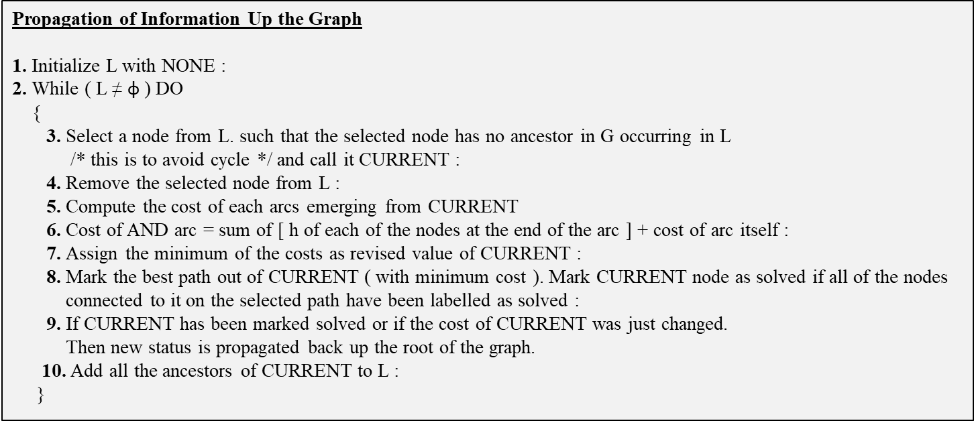

Slide 13
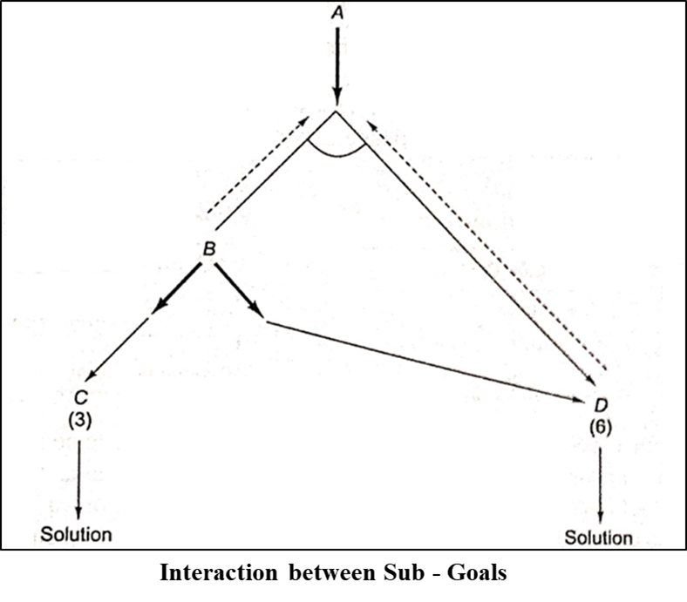

Slide 14
Game Playing
A game is defined as sequence of choices where each choice is made from a number of discrete alternatives.
Each sequence ends with an outcome and every outcome has a definite value for the opening player.
Here, two players games are considered in which both players have exactly opposite goals.

Slide 15
Games are classified into:
i. Perfect information games
Example: Tic-tac-toe, chess, checkers etc.,
ii. Imperfect information games
Example: Cards, Dice etc.,
Will study about discrete and perfect information games.
A game is said to be discrete, if it contains a finite number of states or configurations.
While playing a game, we need to look ahead at future positions in order to succeed

Slide 16
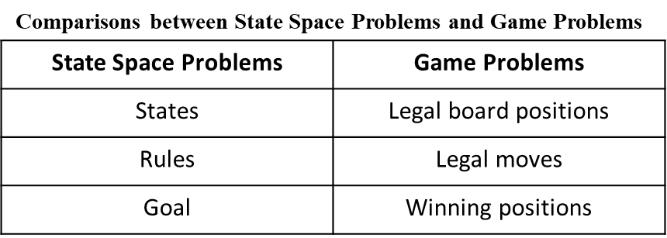
Game problem versus state space problem

Slide 17
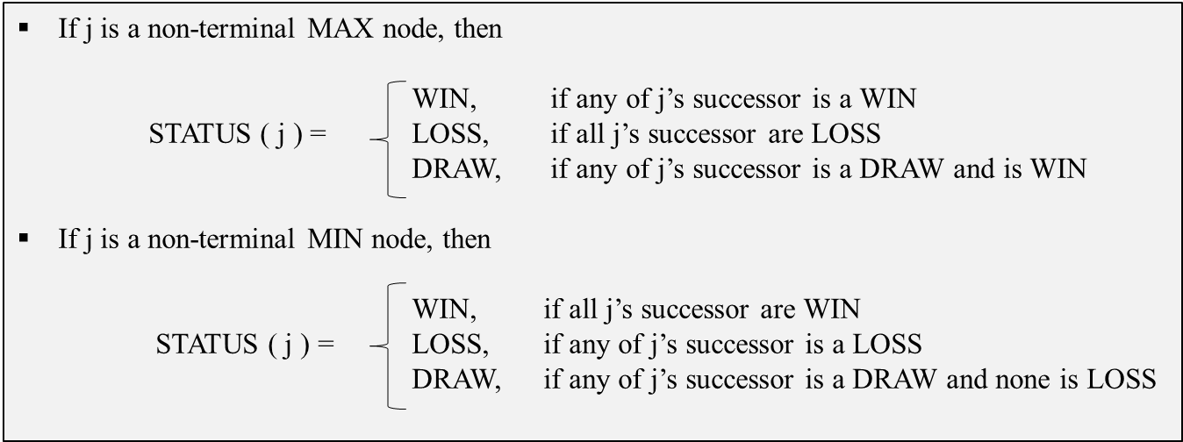
Status labelling procedure in game tree

Slide 18
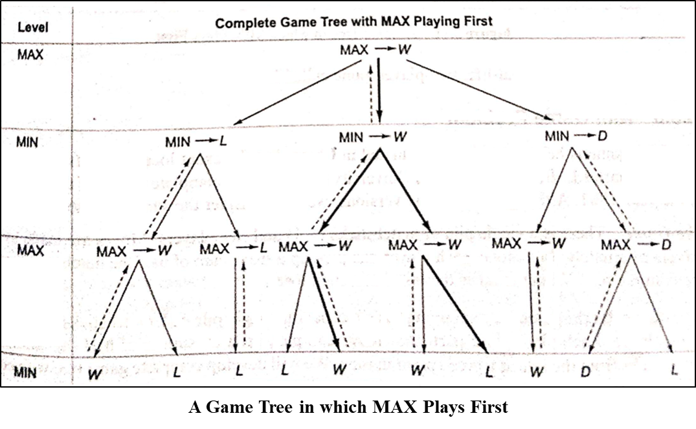

Slide 19
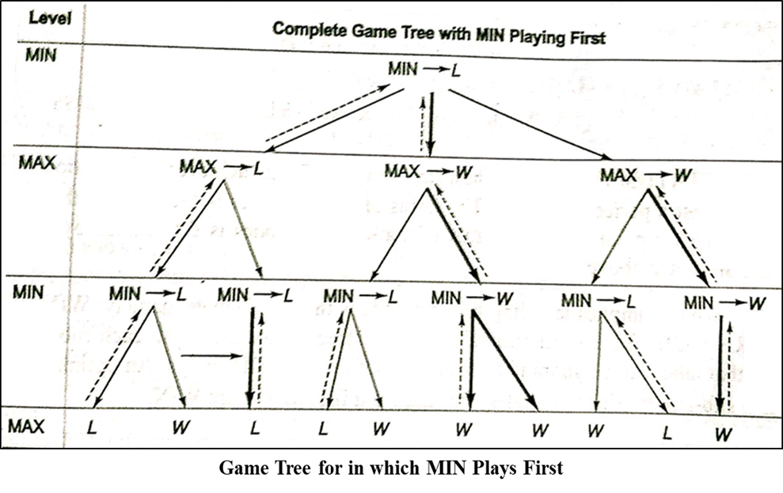

Slide 20
Nim Game Problem
There is a single pile of matchsticks (>1) and two players
Moves are made by the player alternately
In each move, each player can pick up a maximum of half the number of matchsticks in the pile.
Whoever picks the last matchstick loses.

Slide 21
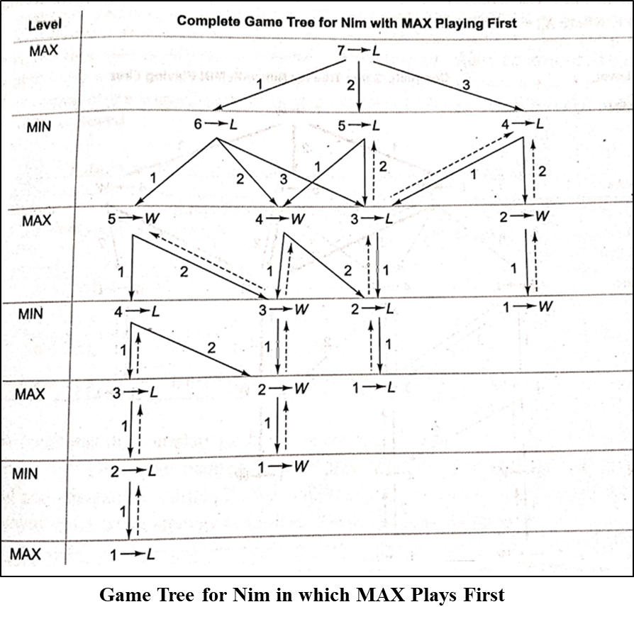
Nim Game Problem
Mark status of terminal
Mark the status of non terminal by using status labelling procedure
Root (MAX→L)
MIN always wins irrespective of the move made by the first player

Slide 22
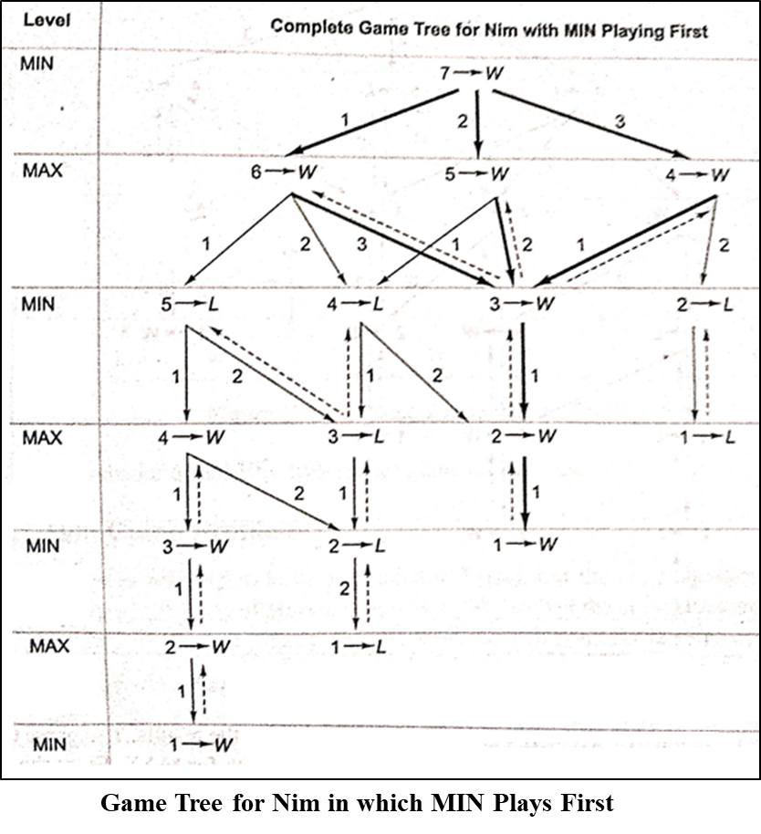
Nim Game Problem
Mark status of terminal
Mark the status of non terminal by using status labelling procedure
Root (MIN→W)
MIN always wins irrespective of the move made by the first player

Slide 23
Strategy
If at the time of MAX player’s turn there are N matchsticks in a pile ,
then Max can force a win by leaving M matchsticks for the MIN player to play , where
M ∈ {1,3,7,15,31,63,…}
using the rule of game (that is MAX can pick up a maximum of half the number of matchsticks in the pile).
The sequence {1,3,7,15,31,63,…} can be generated using the formula
X_{i} = 2 X_{i-1} + 1 for i >0 where X₀ =1

Slide 24

Strategy
First method
Look up from the sequence {1,3,7,15,31,63,…} and figure out the closest number less than the given number N of match sticks in the pile .
The difference between N and the number gives the desired number of sticks that have to be picked up .
For example , if N=45,the closest number to 45 in the sequence is 31, so we obtain the desired number of matchsticks to be picked up as 14 on subtracting 31 from 45.
This way try to maintain a sequence {1,3,7,15,31,63,…}.
Second method
the desired number is obtained by removing the most significant digit from the binary representation of N and adding it to the least significant digit position.
N | Binary Representation | Sum of 1 with MSD removed from N | Number of sticks to be removed | Number left in pile
13 | 1101 | 0101+0001 | 0110=6 | 7
27 | 11011 | 01011+00001 | 01100=12 | 15
36 | 100100 | 000100+000001 | 000101=5 | 31
70 | 1000110 | 0000110+0000001 | 0000111=7 | 63

Slide 25
MAX - WIN
We can formulate two cases where MAX will always win if the following strategy is applied.
CASE 1 MAX is the first player and initially there are
N ∉ {3,7,15,31,63,…} matchsticks.
CASE 2 MAX is the second player and initially there are
N ∈ {3,7,15,31,63,…} matchsticks.

Slide 26
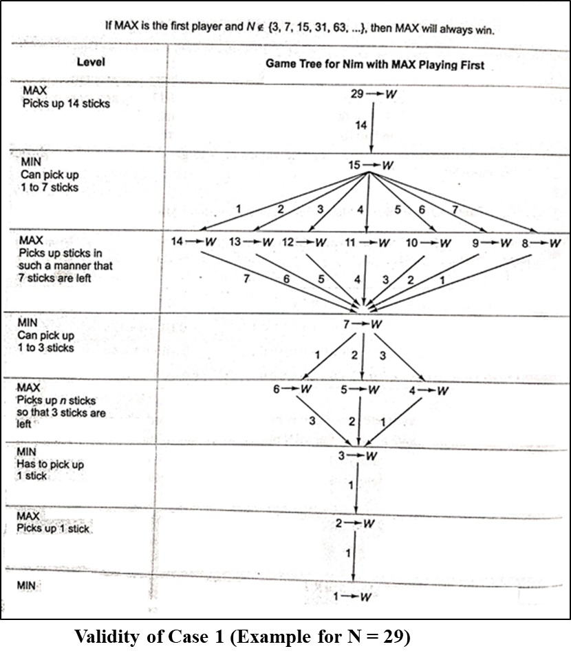
Validity of Cases for Winning of MAX Player
CASE 1 If MAX is the first player and
N ∉ {3,7,15,31,63,…}.
MAX will always win.
Consider a pile of 29 sticks and let MAX be the first player.

Slide 27
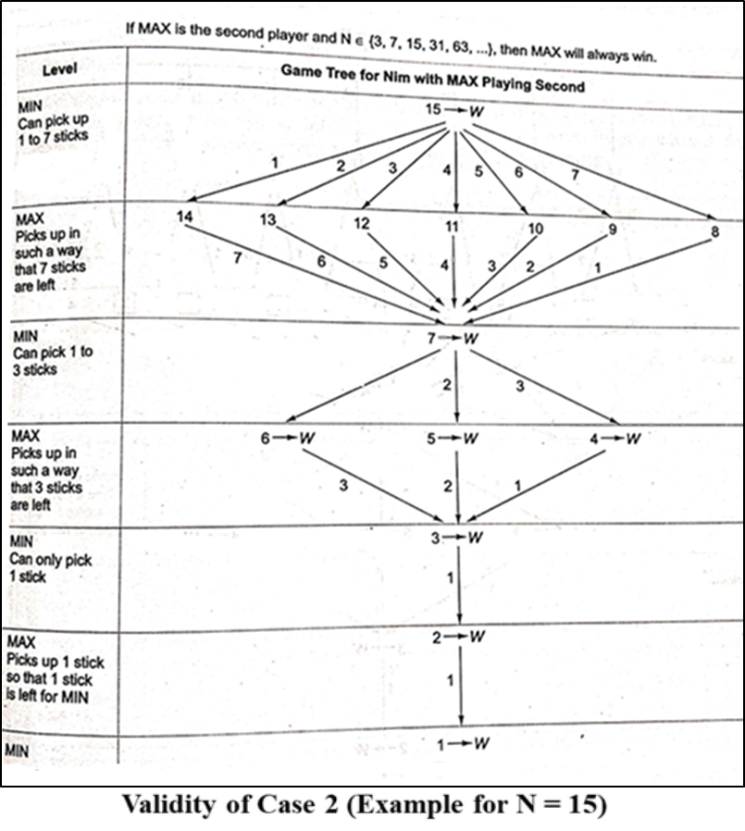
Validity of Cases for Winning of MAX Player
CASE 2 If MAX is the second player and
N ∈ {3,7,15,31,63,…}
Consider a pile of 15 sticks and let MAX be the second player.
The complete game tree for this case is shown in fig.

Slide 28
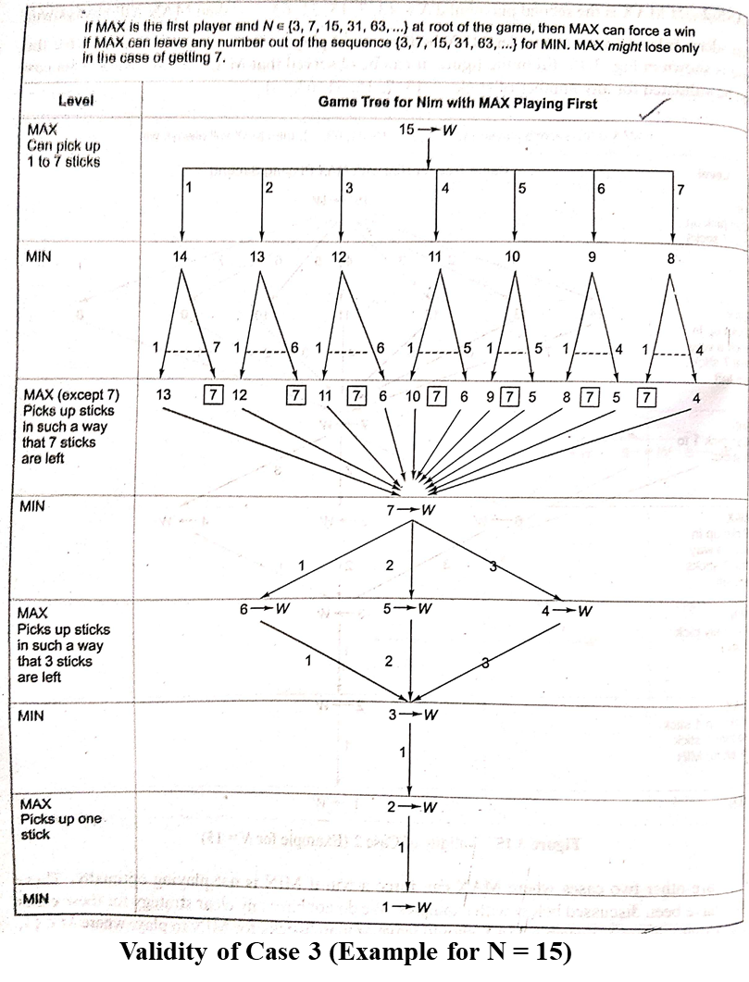
Validity of Cases for Winning of MAX Player
CASE 3 If MAX is the first player and N ∈ {3,7,15,31,63,…} at root of the game,
MAX can force a win using the strategy mentioned above in all cases except when MAX gets a number from the sequence {3,7,15,31,63,…} at its turn.
Assume that N=15 fig 1 shows that MAX wins in all cases except when it gets 7 matchsticks in its turn.

Slide 29
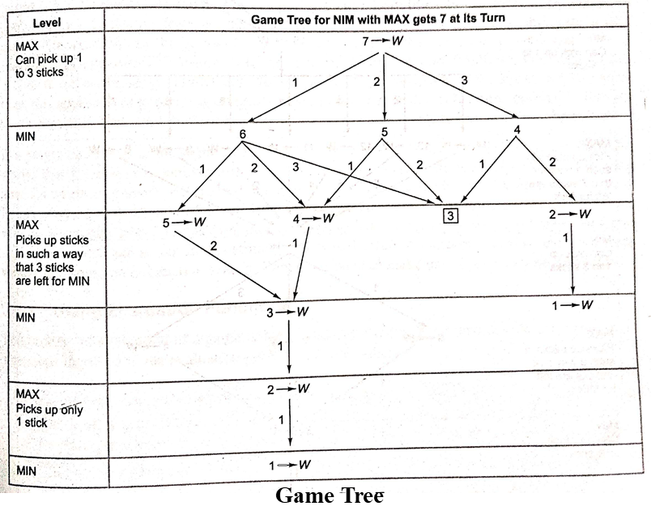
Validity of Cases for Winning of MAX Player
MAX can even win the game when it gets 7 sticks at its turn in the game for all values except when it gets 3 sticks at its turn in the game.

Slide 30
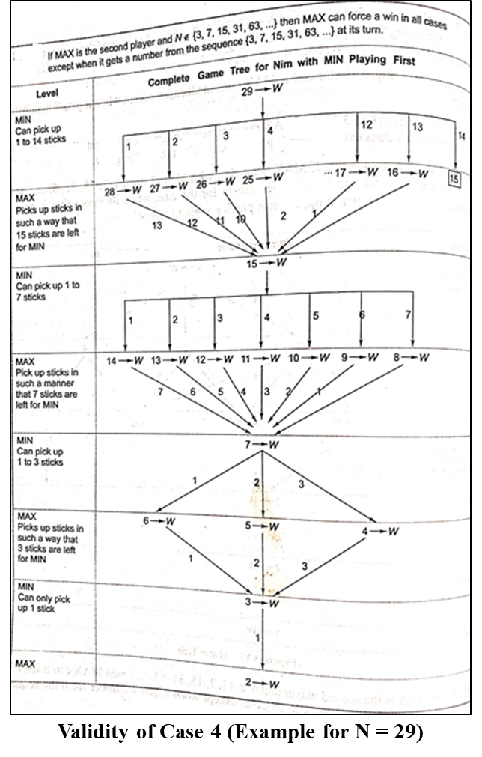
Validity of Cases for Winning of MAX Player
CASE 4 If MAX is the second player and N ∉ {3,7,15,31,63,…} then MAX can force a win using the above mentioned strategy in all cases except when it gets a number from the sequence {3,7,15,31,63,…} at its turn.
Let N=29
Let MIN be the first player.
MAX wins in all cases except when it gets 15 matchsticks at its turn.
Max might lose in case of it getting 15.

Slide 31
Bounded Look-Ahead Strategy and use of Evaluation Functions
Status labelling procedure requires the generation of complete tree or atleast some part of it
For many games in reality too large trees may be generated & need to be evaluated backward from terminal to root in order to determine the optimal first move.
This approach may not be practical
It is better to look for about few levels before deciding the move
Look-ahead strategy : The player can develop the game tree to some extent before deciding on the move.
N-move Look-ahead strategy : The player is looking ahead n no of levels before making a move.

Slide 32
Bounded Look-Ahead Strategy and use of Evaluation Functions
Using Evaluation Functions
The first step is to decide which features are of value in a particular game.
The next step is to provide each feature with a range of possible values.
The last step is to devise a set of weights in order to combine all the feature values into a single value.
Alternative is using heuristic approximation.
A proper static evaluation function can convert all judgments about board situations into a single overall quality number
Function provides numerical assessment which indicates the favorable condition for MAX.
+ve value ⇒ good and -ve value ⇒ bad for MAX.
The heuristic value of nodes are determined at some level (one-ply /two-ply).
The procedure through which the scoring information travels up the game is called MINIMAX procedure

Slide 33
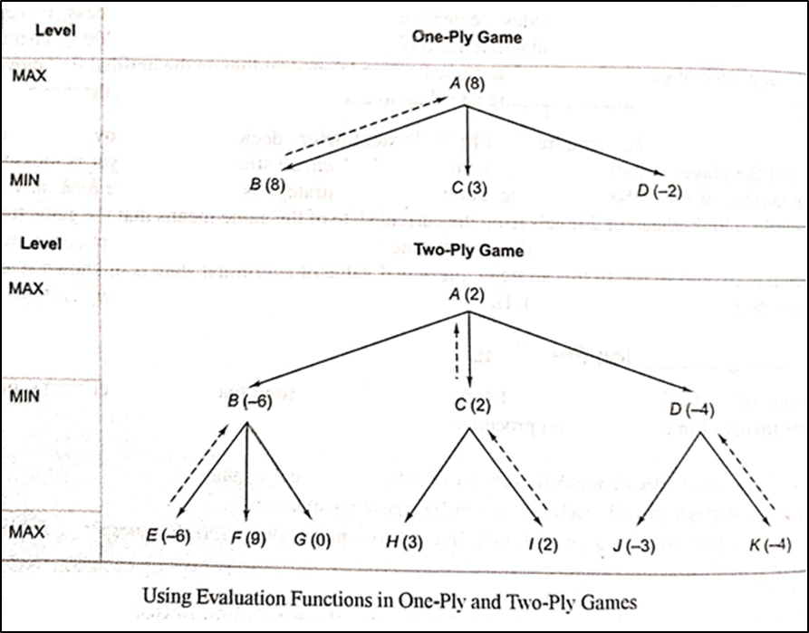
One-Ply & two-Ply

Slide 34
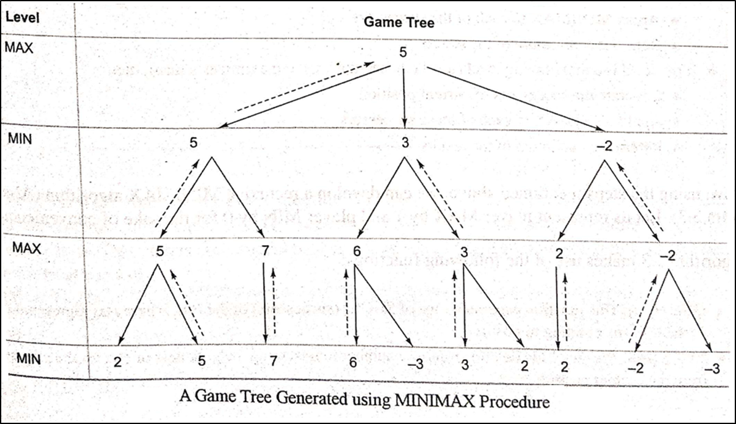
MINIMAX Procedure
It is the procedure through which the scoring info travels up the game tree.
Propagates to root, the estimated score generated by heuristic evaluation function.
It is recursive algorithm.
Player tries to maximize its chance of a win while minimizing that of the opponent.
A player with +ve number is maximizing player
A player with –ve number is minimizing player
A each move MAX player tries to take a path that leads to a large +ve number while opponent will try to face the game towards –ve static evaluation.

Slide 35
MINIMAX Procedure
The algorithmic steps of this procedure may be written as:
Keep on generating the search tree till the limit, say depth d of the tree, has been reached from the current position.
Compute the static value of the leaf nodes at depth d from the current position of the game tree using evaluation function.
Propagate the values till the current position based on MINIMAX strategy.

Slide 36
MINIMAX Strategy
Steps in MINIMAX strategy are written as follows:
If the level is minimizing level(level reached during minimizer’s turn),then
Generate the successors of the current position
Apply MINIMAX to each of the successors
Return the minimum of the results
If the level is maximizing level(level reached during maximizer’s turn),then
Generate the successors of the current position.
Apply MINIMAX to each of the successors
Return the maximum of the results

Slide 37
MINIMAX Algorithm
The functions used are:
GEN(Pos) : This function generates a list of SUCCs (successors) of the Pos , where Pos represents a variable corresponding to position.
EVAL(Pos, Player) : This function returns a number representing the goodness of Pos for the player from the current position.
DEPTH(Pos, Depth) : It is a Boolean Function that returns true if the search has reached the maximum depth fro the current position , else it return false.

Slide 38
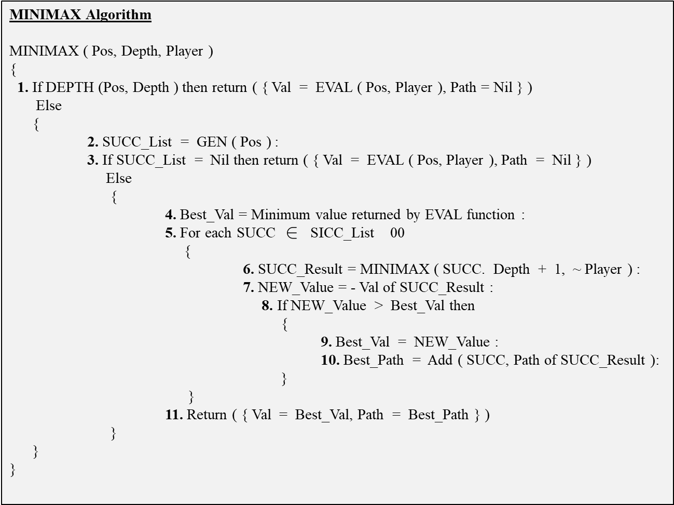
MINIMAX Algorithm

Slide 39
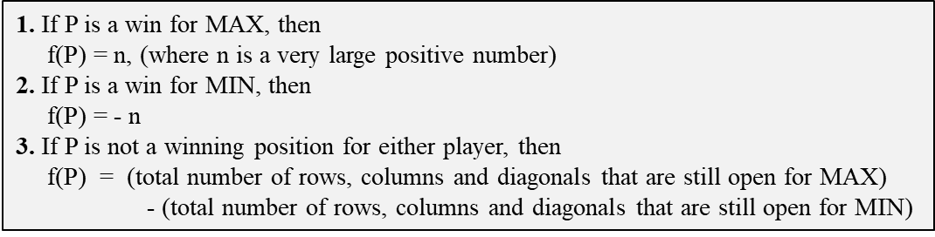
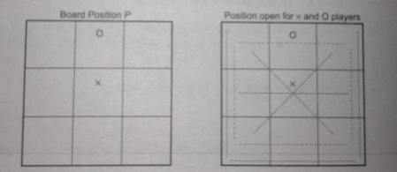
Example: Tic-Tc-Toe Game
Figure. Board Position for a Game of Tic-Tac-Toe

Slide 40
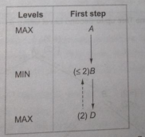
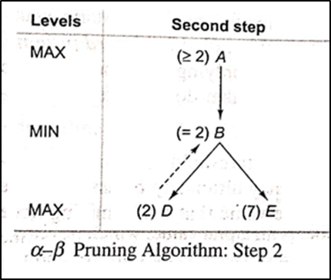
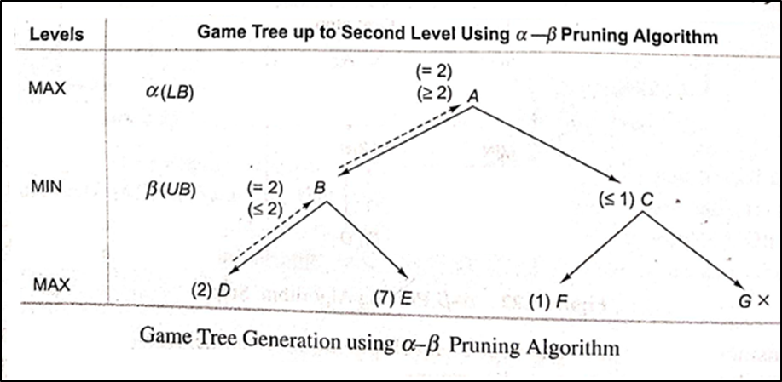
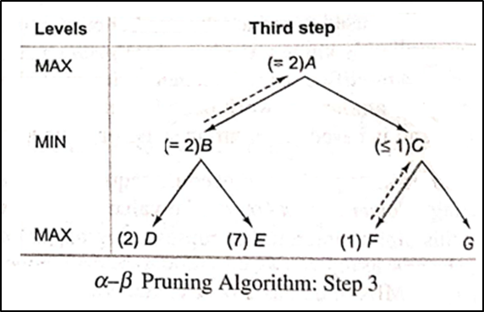
Alpha-Beta Pruning
Figure. Alpha –Beta pruning Algorithm: Step 1

Slide 41
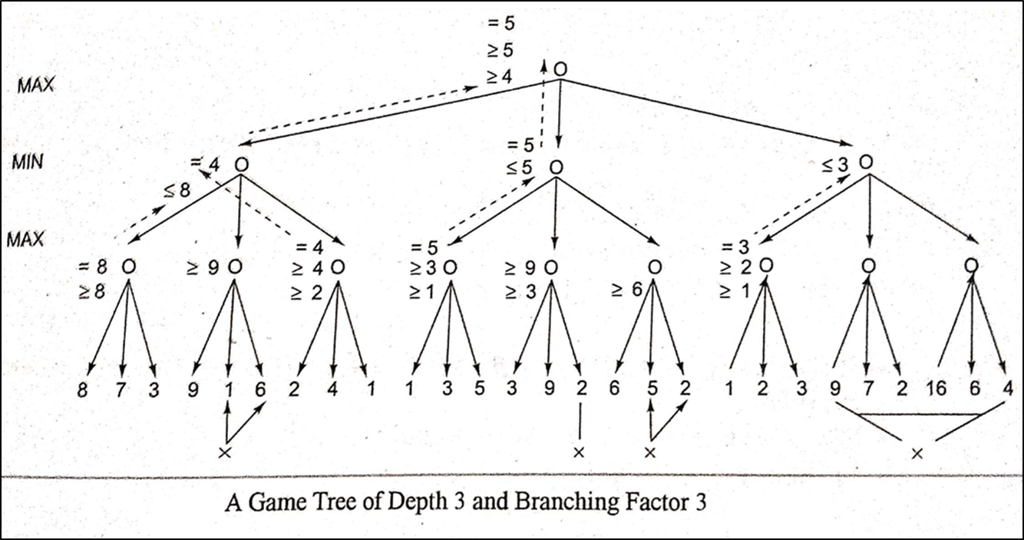

Slide 42
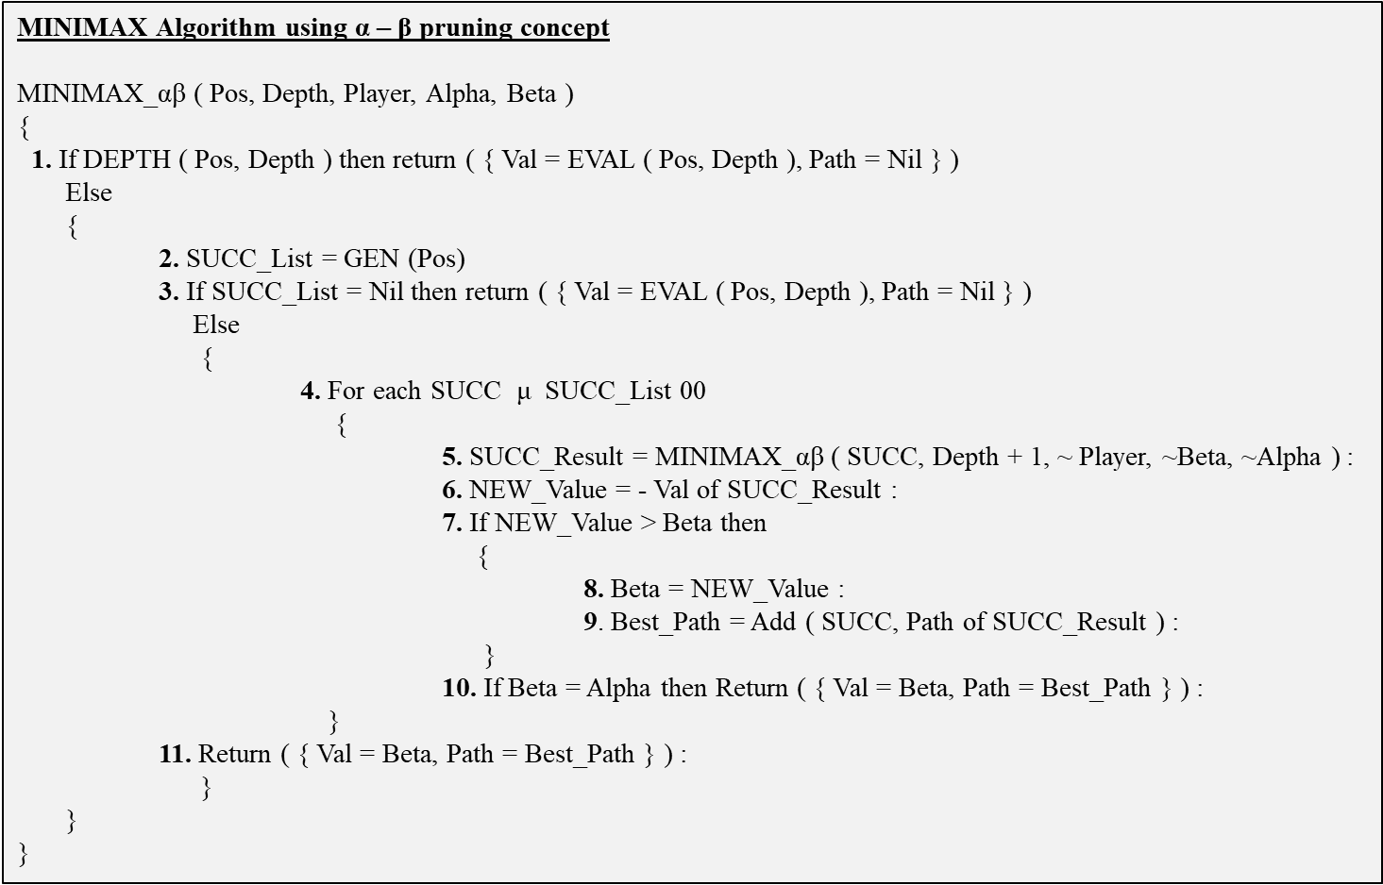

Slide 43
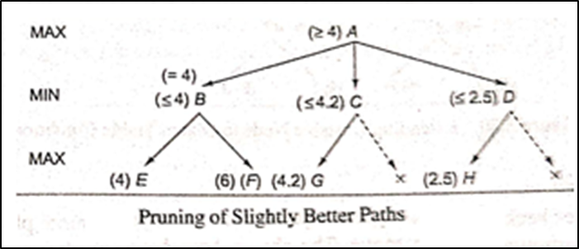
Refinement's to Alpha-Beta Pruning
Pruning of slightly better paths

Slide 44
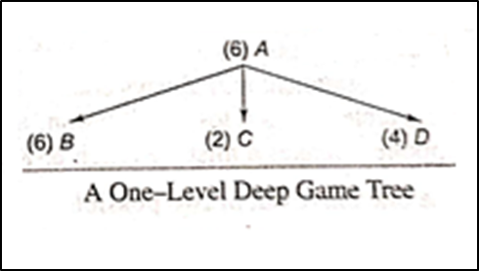
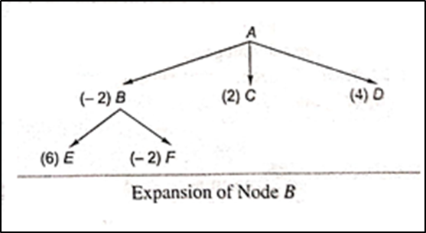
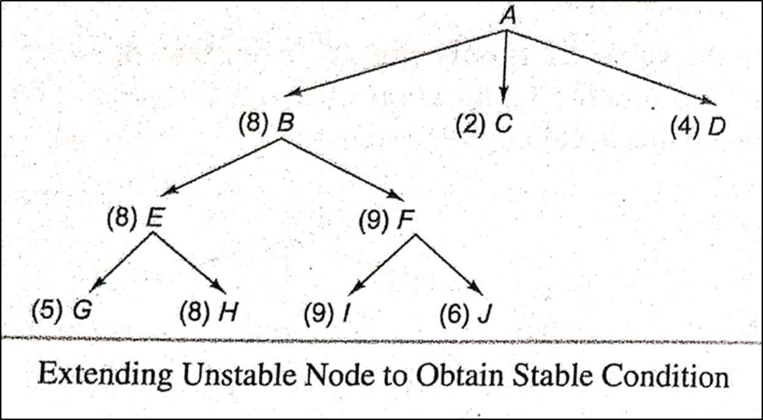
Refinement's to Alpha-Beta Pruning
Waiting for Quiescence

Slide 45
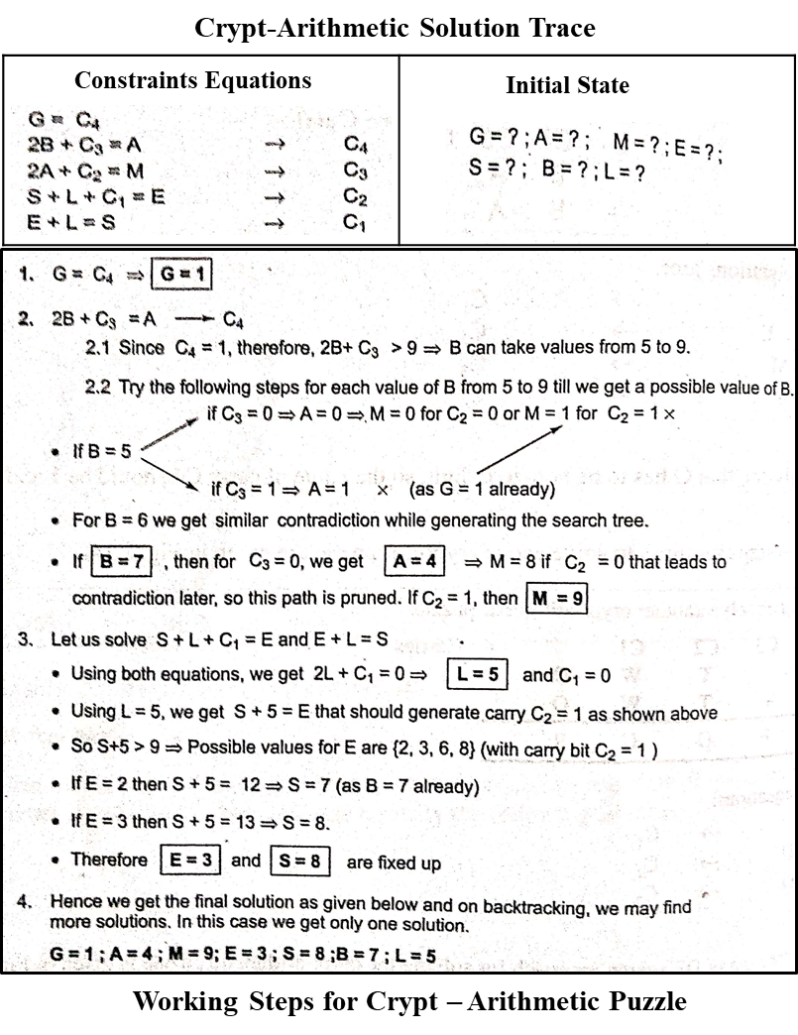
Constraint Satisfaction

Slide 46
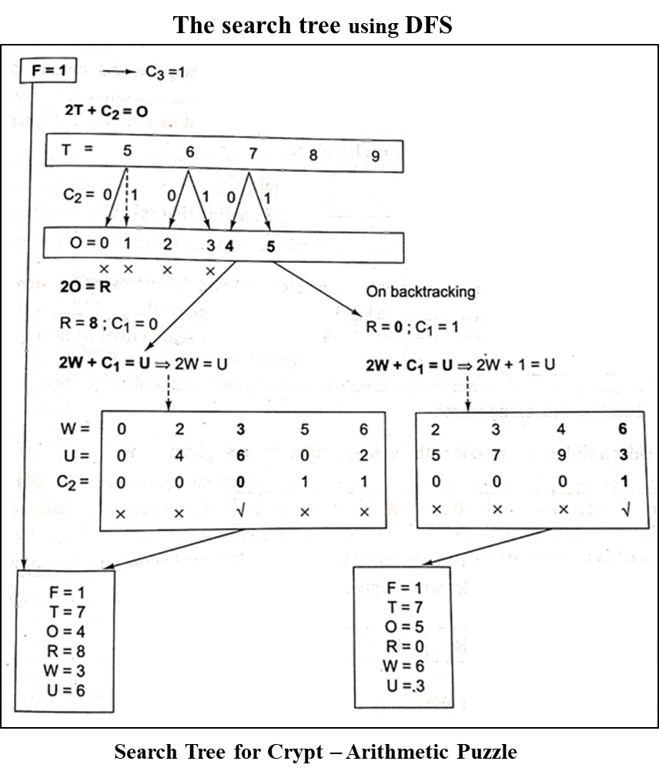
Constraint Satisfaction

